Slide 1
Selenium Web Driver Project for Cognition Technology Website By: Pratiksha Chaudhari (2021-5532) Guided By : Amruta Deore

Slide 2
Introduction About Website
This website is for fill-up the registration form.
In this project our main focus is to test the registration module.
In registration form, the different web element are available for testing purpose.

Slide 3
Launch the browser and Cognition Technology Website
System.setProperty("webdriver.chrome.driver","C:\\seleniumwebdriver\\chromedriver\\chromedriver.exe");
WebDriver driver =new ChromeDriver();
//open the website
driver.get("https://www.cognitech.in/placement-registeration/?looking_for=Registration#");

Slide 4
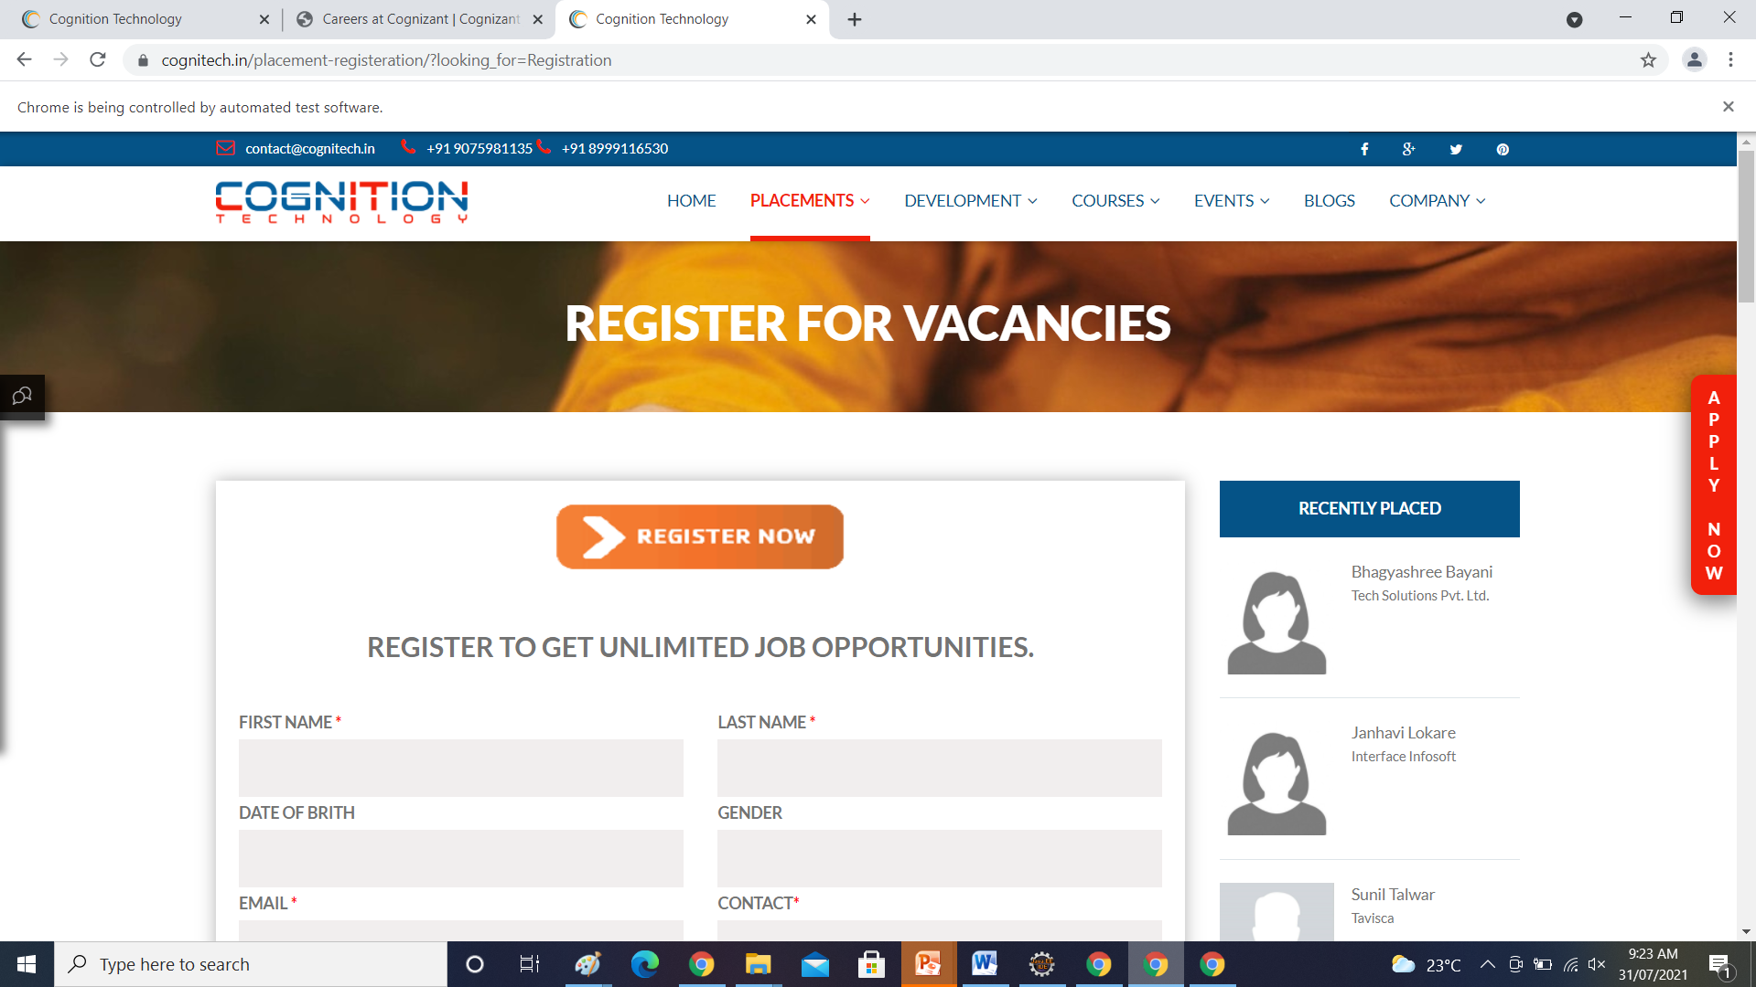

Slide 5
To verify the functionality of text box
driver.findElement(By.name("firstName")).sendKeys("Pratiksha");
driver.findElement(By.name("lastName")).sendKeys("Chaudhari");
driver.findElement(By.name("dob")).sendKeys("16/03/1996");
driver.findElement(By.name("gender")).sendKeys("Female");
driver.findElement(By.name("email")).sendKeys("chaudharipratiksha163@gmail.com"); driver.findElement(By.name("contact")).sendKeys("9075020319");

Slide 6
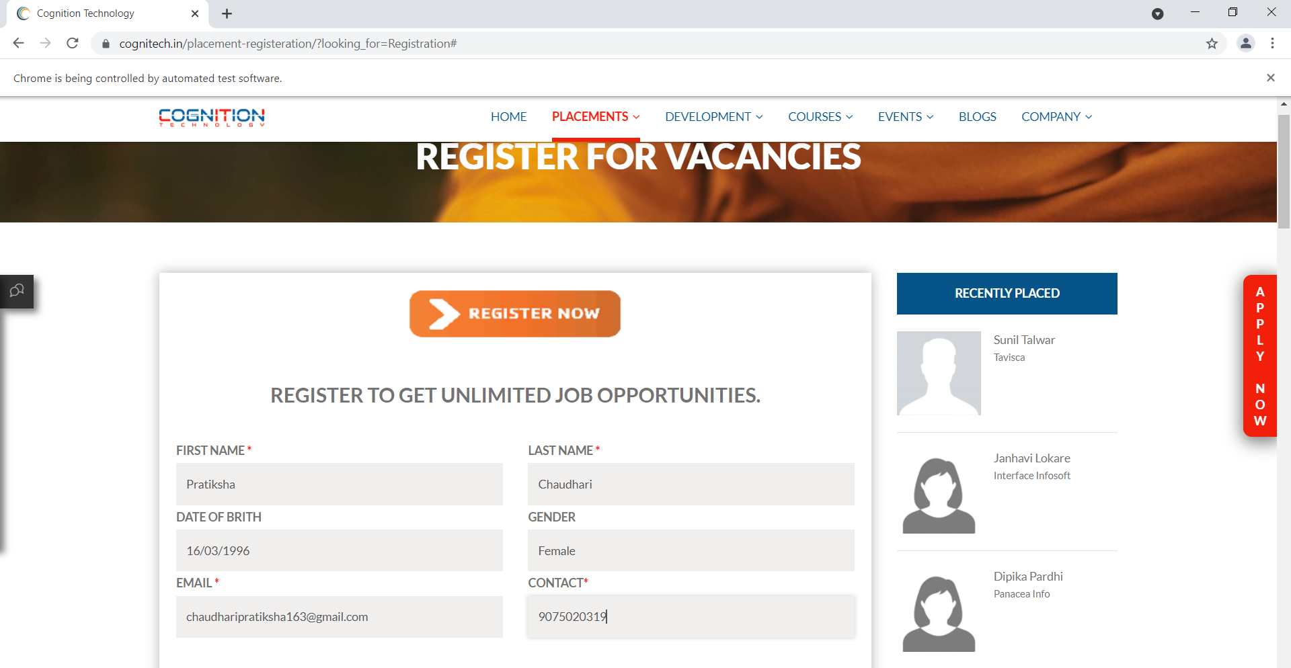

Slide 7
To verify the functionality of text box
driver.findElement(By.name("pg")).sendKeys("M. Tech");
driver.findElement(By.name("pgSpecial")).sendKeys("Electronics Engineering");
driver.findElement(By.name("pgUni")).sendKeys("Shivaji University"); driver.findElement(By.name("pgYear")).sendKeys("2020");
driver.findElement(By.name("pgAggregate")).sendKeys("8.45 CGPA");
driver.findElement(By.name("pgFinal")).sendKeys("7.74 CGPA");

Slide 8
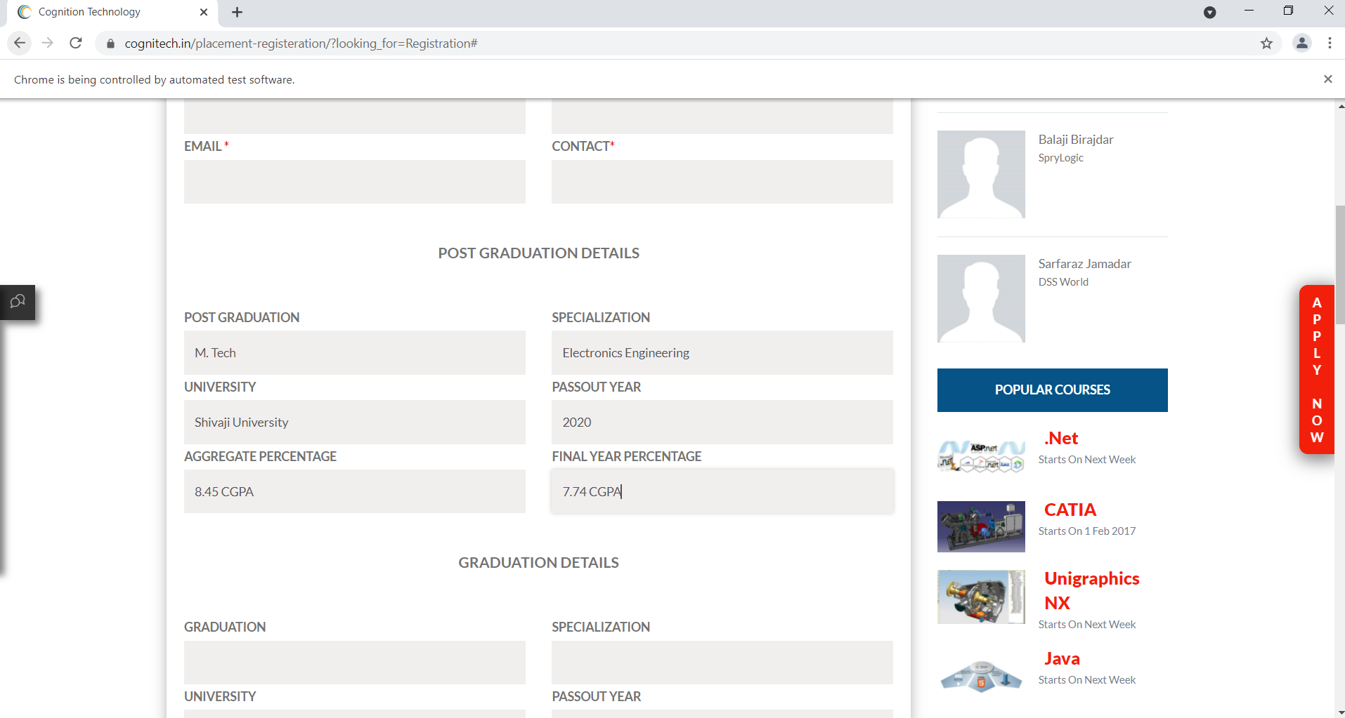

Slide 9
To verify the functionality of text box
driver.findElement(By.name("grad")).sendKeys("BE");
driver.findElement(By.name("gradSpecial")).sendKeys("E&TC");
driver.findElement(By.name("gradUni")).sendKeys("Shivaji University");
driver.findElement(By.name("gradYear")).sendKeys("2018");
driver.findElement(By.name("gradAggregate")).sendKeys("80%");
driver.findElement(By.name("gradFinal")).sendKeys("67.19%");

Slide 10
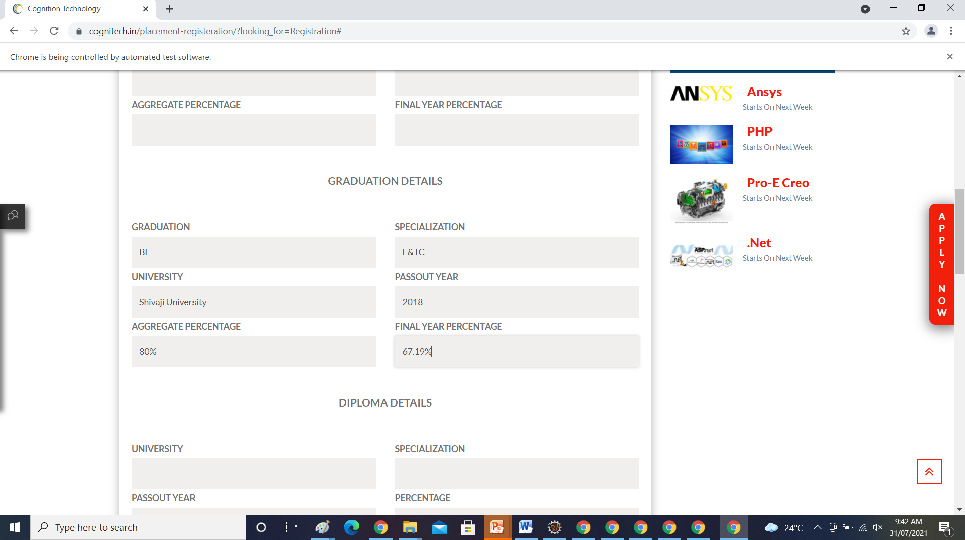

Slide 11
To verify the functionality of text box
driver.findElement(By.name("dipUni")).sendKeys("NA");
driver.findElement(By.name("dipSpecial")).sendKeys("NA");
driver.findElement(By.name("dipYear")).sendKeys("NA");
driver.findElement(By.name("dipPercentage")).sendKeys("NA");

Slide 12
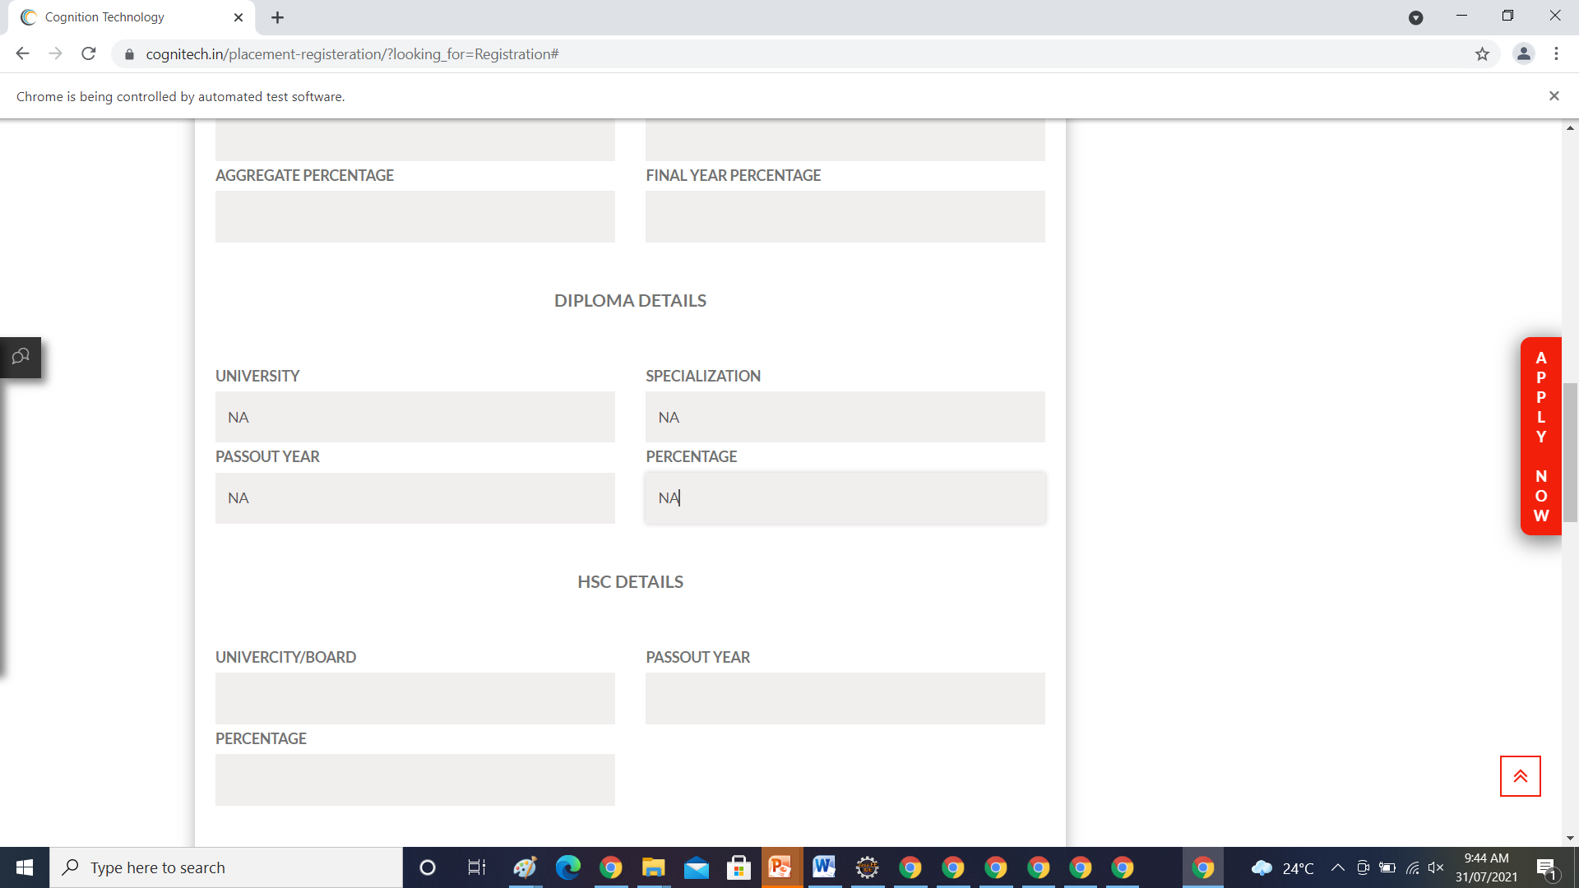

Slide 13
To verify the functionality of text box
driver.findElement(By.name("hscUni")).sendKeys("Maharasgtra State Board");
driver.findElement(By.name("hscYear")).sendKeys("2013");
driver.findElement(By.name("hscPercentage")).sendKeys("60");
driver.findElement(By.name("sscUni")).sendKeys("Maharasgtra State Board");
driver.findElement(By.name("sscYear")).sendKeys("2011");
driver.findElement(By.name("sscPercentage")).sendKeys("76.36");

Slide 14


Slide 15
To verify the functionality of text box
driver.findElement(By.name("globalCert")).sendKeys("Software Testing");
driver.findElement(By.name("skills")).sendKeys("Manual Testing, Automation Testing");
driver.findElement(By.name("sscPercentage")).sendKeys("76.36%");
driver.findElement(By.name("exp")).sendKeys("Fresher");
driver.findElement(By.name("comp")).sendKeys("Edubridge Pvt. Ltd.");
driver.findElement(By.name("pre")).sendKeys("Pune");

Slide 16
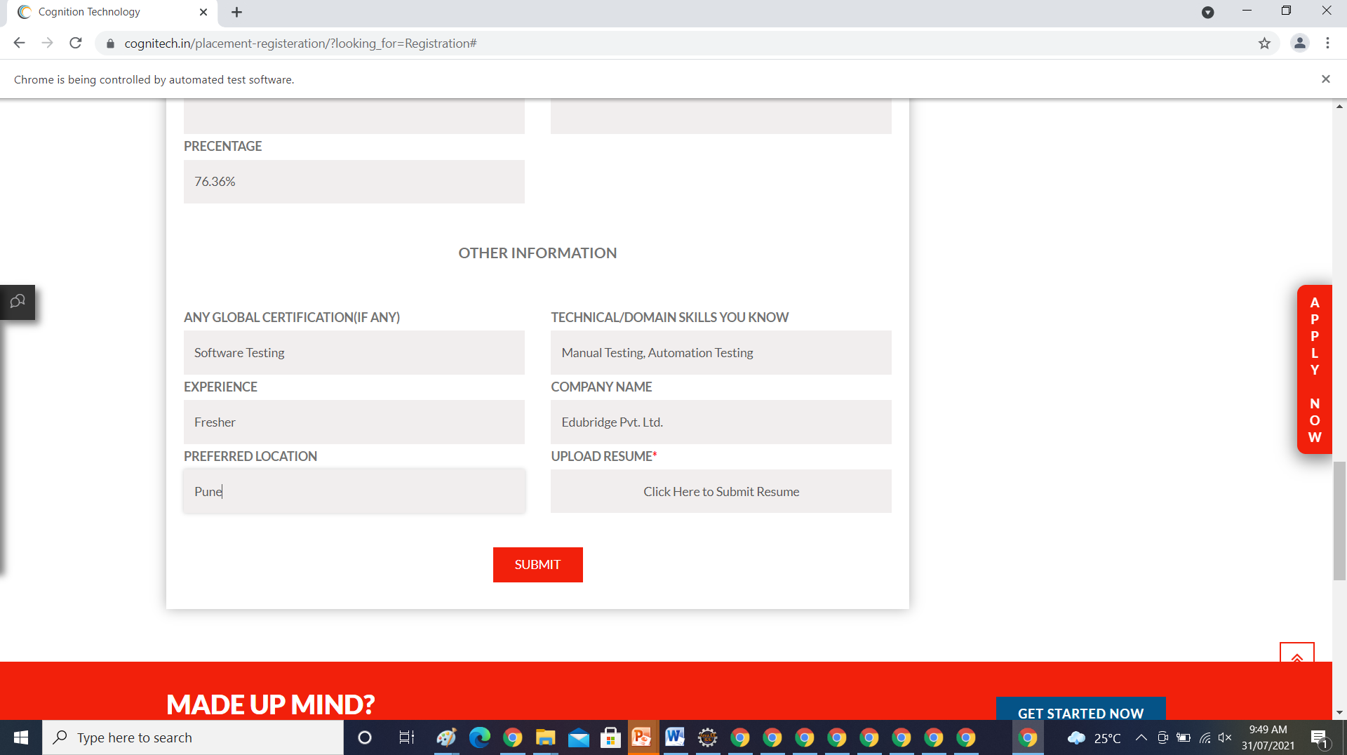

Slide 17
To check the functionality of submit the document
driver.findElement(By.name("open_modal_btn")).click();
driver.findElement(By.xpath("//*[@id=\"resumeForm\"]/input[1]")).sendKeys("D:\\software test engineer resume fresher.pdf");

Slide 18
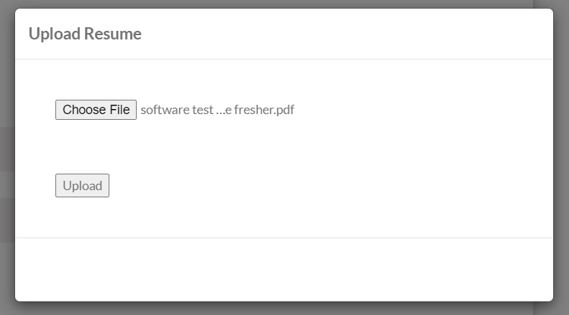

Slide 19
To check the functionality of upload document
driver.findElement(By.name("upload_resume_btn")).click();

Slide 20
To check the functionality of submit button
driver.findElement(By.xpath("//*[@id=\"place_form\"]/div[3]/button/span")).submit();

